Slide 1
Usability Improvement
SeqAn – BioStore Workshop 2012

Slide 2
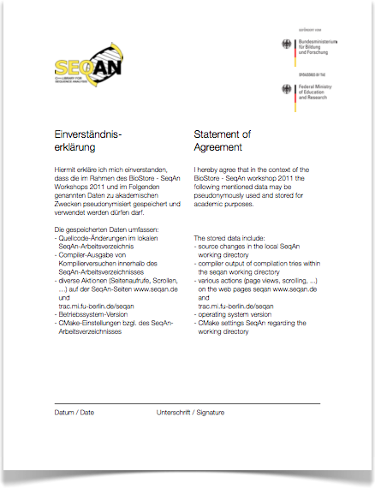

Goal
Usability improvement
Requirements
less time
satisfactory results
Observation needed
Experiment within this workshop
Notes:
better meets your requirements

Slide 3



Data Collection
#1 Random ID
#2 Progress Data
core data
os version
development environment
diff files
seqan.de usage
Notes:
What you can do voluntarily is

Slide 4
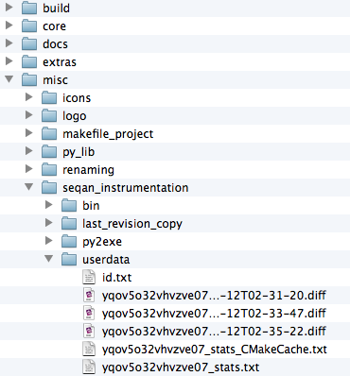

Transmitted Data
--- alignment.cpp 2011-09-12 02:26:03 +++ alignment.cpp 2011-09-12 02:35:17 @@ -1,4 +1,4 @@ -///A tutorial about alignments. +///A tutorial about global alignments.
"machine": {
"machine": "x86_64",
"processor": "i386",
"architecture": "64bit”
},
"devenv": {
"CMAKE_CXX_COMPILER”: "/usr/bin/g++",
"CMAKE_GENERATOR”: "Xcode”
}, "os": {
"platform": "Darwin-11.1.0-64bit”
}
yqov5o32vhvzve07
Notes:
I want to give you an understanding of the
nature of data transmitted to our SeqAn server.
checked out
you see this tree of directories

Slide 5

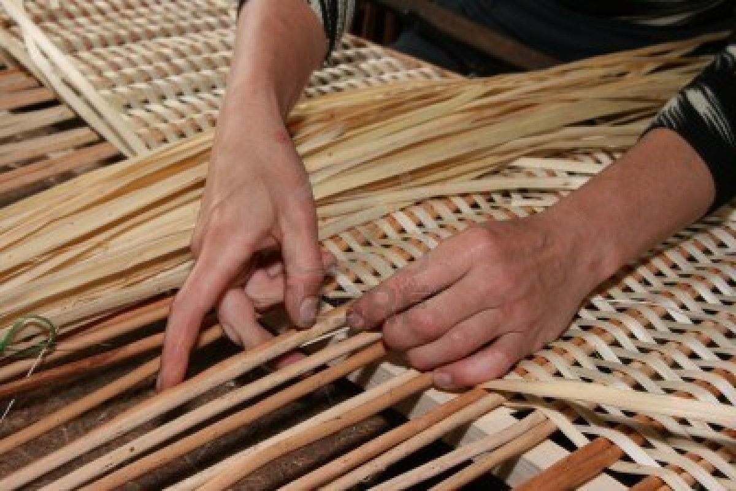
Privacy
seqan.de
Notes:
Limited to seqan.de
pseudonymised data collection
activated manully

Slide 6



Activation
cd seqan-trunk
touch > SUA
echo "" > SUA
cd ../seqan-trunk-build/xcode
cmake .

Slide 7
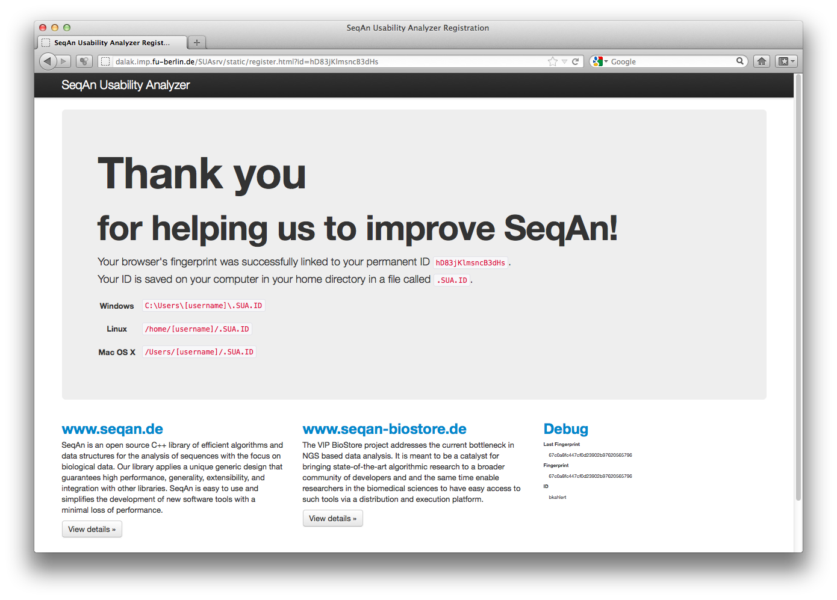

Slide 8
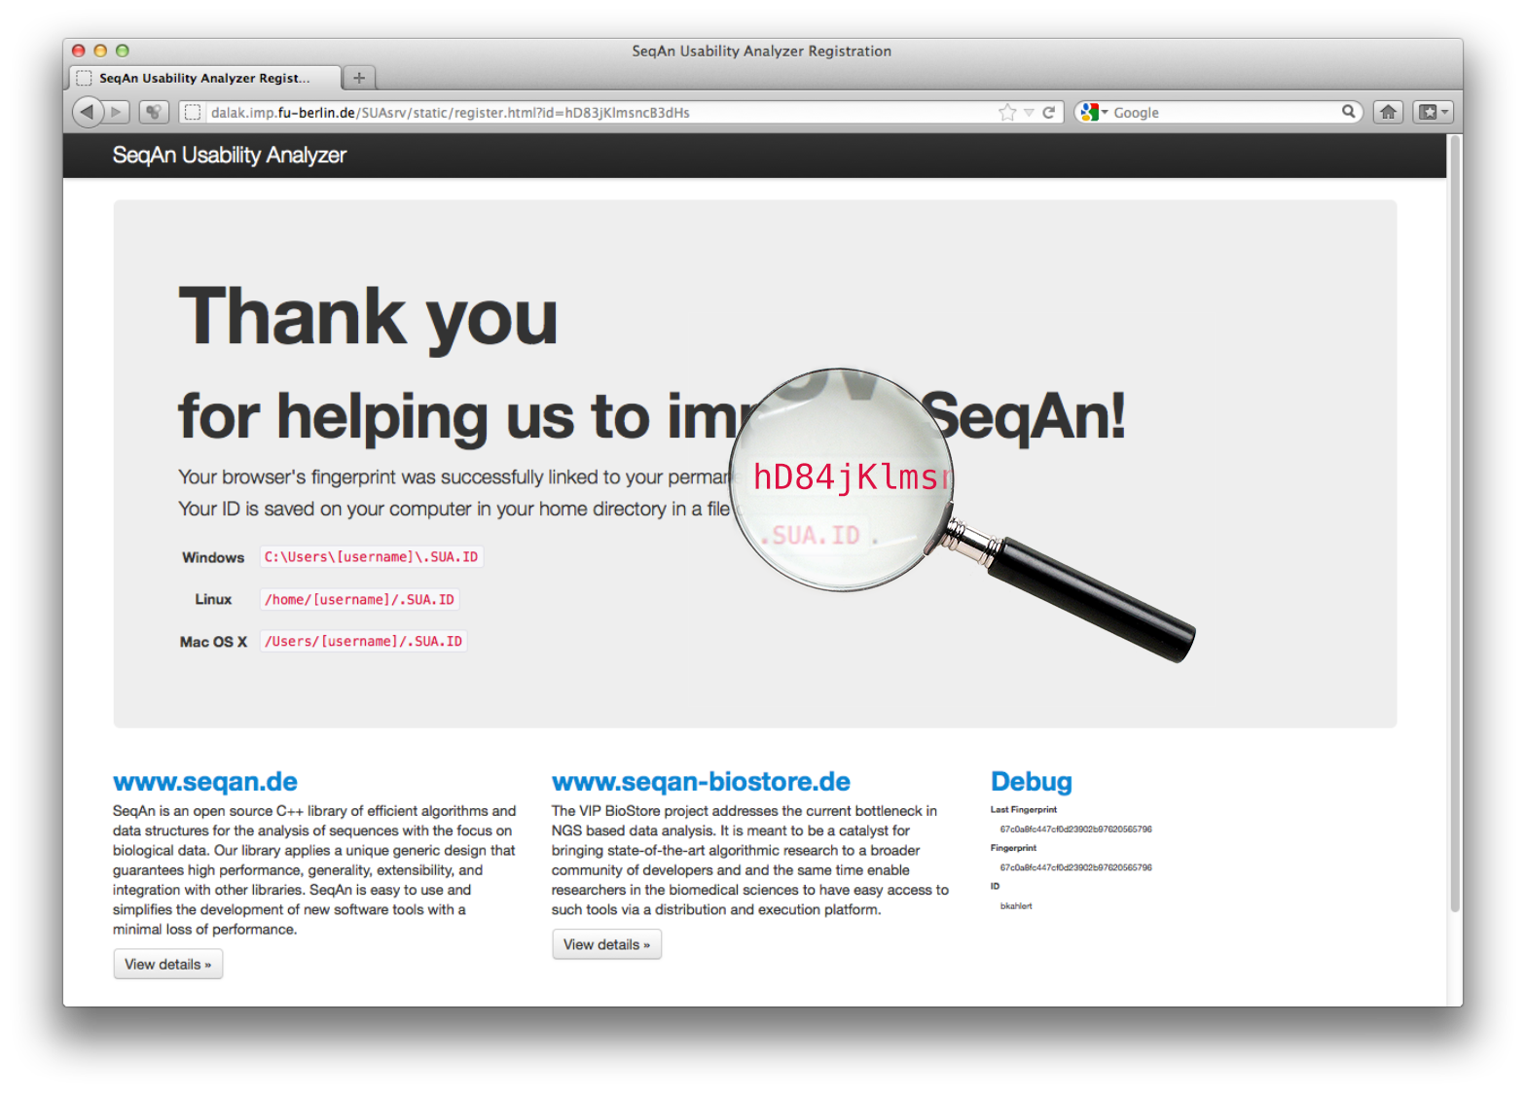

Slide 9
hD84

Slide 10
Summary
diff and doc usage logged
privacy
create file SUA in seqan-trunk
seqan-trunk$ echo "" > SUA
run cmake
Have fun using SeqAn!
Thank you for taking part in the experiment!

